Slide 1
Relational Model
Relational model concepts
Relational constraints and relational database schemas
Update operations and dealing with constraint violations
Relational algebra
Summary
Notes:
The imitation game (模仿遊戲), Alan Turing (1912-1954)

Slide 2
Relational model concepts
Less is more
Everything is simple tables
Initial problems with the relational model
How to implement it efficiently
By 1975, satisfactory algorithms & storage techniques had been invented
By 1985, relational approach hits the commercial big time

Slide 3
Selling points of the relational approach
Simple
Clean, solid theoretical foundation
Data independence: details of storage are hidden
Relatively easy to write new applications
Non-procedural language for queries and updates
Notes:
Fine $1 per PC down, MS will bankrupt. 2006

Slide 4
Problems with the relational approach
The world is NOT simple tables
Missing information
Complex data types
Additional data semantics (What behavior is reasonable)
Awkward for some types of data
Awkward interface with traditional programming languages
Notes:
ODBC: Open database connectivity
JDBC: Java database connectivity

Slide 5
Relational data model
What is a “data model”?
A notation for describing data
A set of operations used to manipulate that data
A domain is a set of atomic values
Phone_number: a set of 7-digit number valid within a particular area code
Employee_ages: possible ages of employees of a company

Slide 6
Relations
A relation is a finite subset of the Cartesian product of a list of domains.
A relation schema R, denoted by R(A₁,A₂, ..., A_{n}), where R is a relation name.
Each attribute A_{i} is the name of a role played by some domain D. D is called the domain of A_{i} and is denoted by dom(A_{i}).
STUDENT(Name,SSN,HomePhone,Address,OfficePhone,Age,GPA)
Notes:
立法院修法通過民眾一生可以改名3次，嘉義縣一位多次改名的黃姓男子立刻到戶政所申請，一口氣增加4個字，現在他的身分證姓名欄上寫著「黃宏成台灣阿成世界偉人財神總統」，一共15個字，打破內政部公布姓名最長13字紀錄。 (2015)

Slide 7
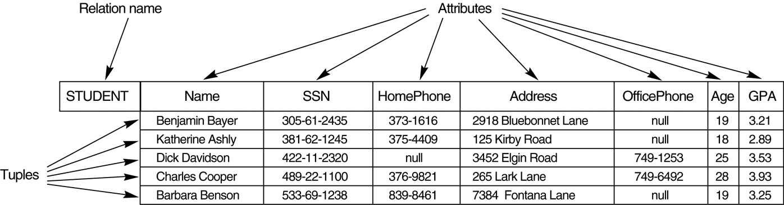
The attributes and tuples of a relation STUDENT

Slide 8
Characteristics of relations
Ordering of tuples in a relation
No order among tuples
No preference for one logical ordering over another
Ordering of values within a tuple, and alternative definition of relation
Values in the tuples
Each value in a tuple is an atomic value.
Composite and multivalued attributes are not allowed.
Interpretation of a relation

Slide 9
Relational constraints and relational database schemas
Domain constraints
Each attribute must be an atomic value.
Key constraints
All tuples in a relation must be distinct.
A relation schema may have more than one key. In this case, each of the keys is called a candidate key.
One of the candidate keys may be designated as the primary key.
Notes:
ID cards are not unique for everyone. There are about 5000 identical IDs in 2000. There are a couple of hundred of identical IDs and around 10 identical IDs in Taipei in 2006.

Slide 10
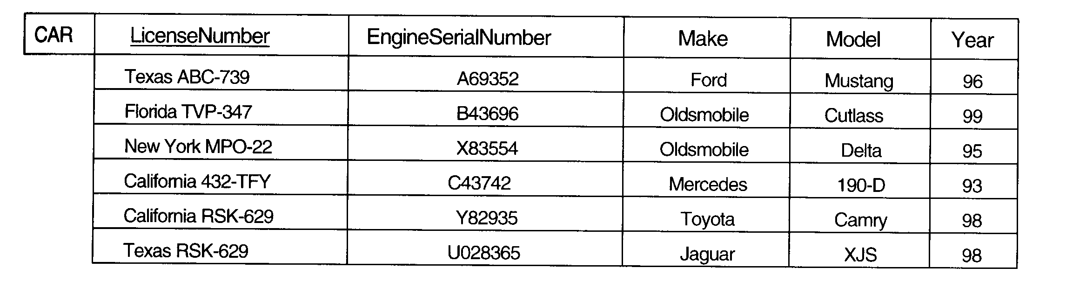
CAR relation with two candidate keys: LicenseNumber and EngineSerialNumber

Slide 11
Relational databases and relational database schemas
A relational database schema S is a set of relation schema S={R₁, R₂, …, R_{m}} and a set of integrity constraints IC.
A relational database state DB of S is a set of relation states DB={r₁, r₂, …, r_{m}} so that each r_{i} is a state of R_{i} and the r_{i} relation state satisfies the integrity constraints specified in IC.

Slide 12
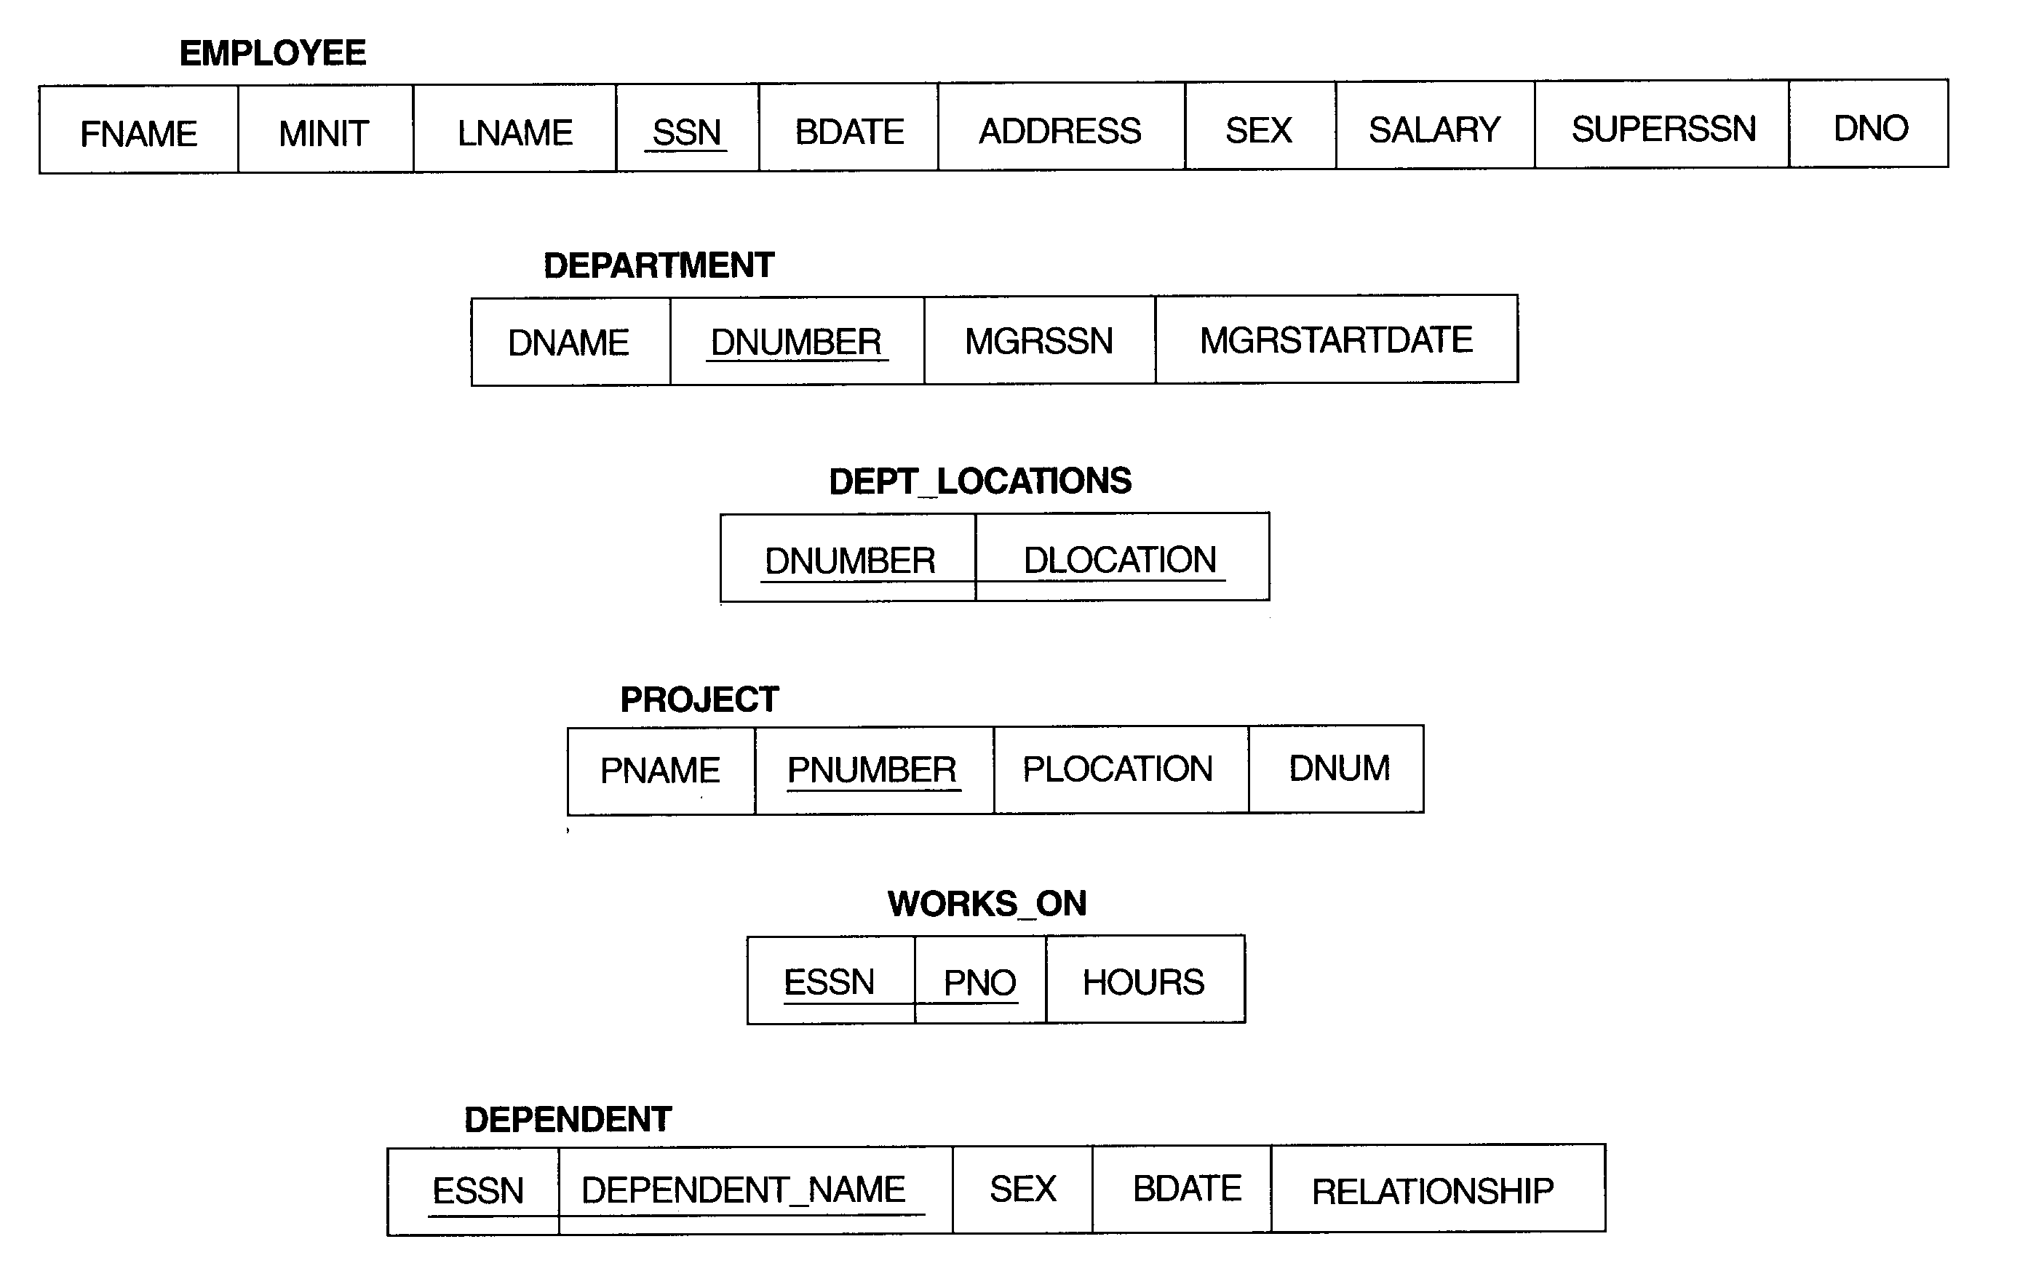
Schema diagram of COMPANY
Notes:
George Foreman
His five sons are George Jr., George III ("Monk"), George IV ("Big Wheel"), George V ("Red"), and George VI ("Little Joey")

Slide 13
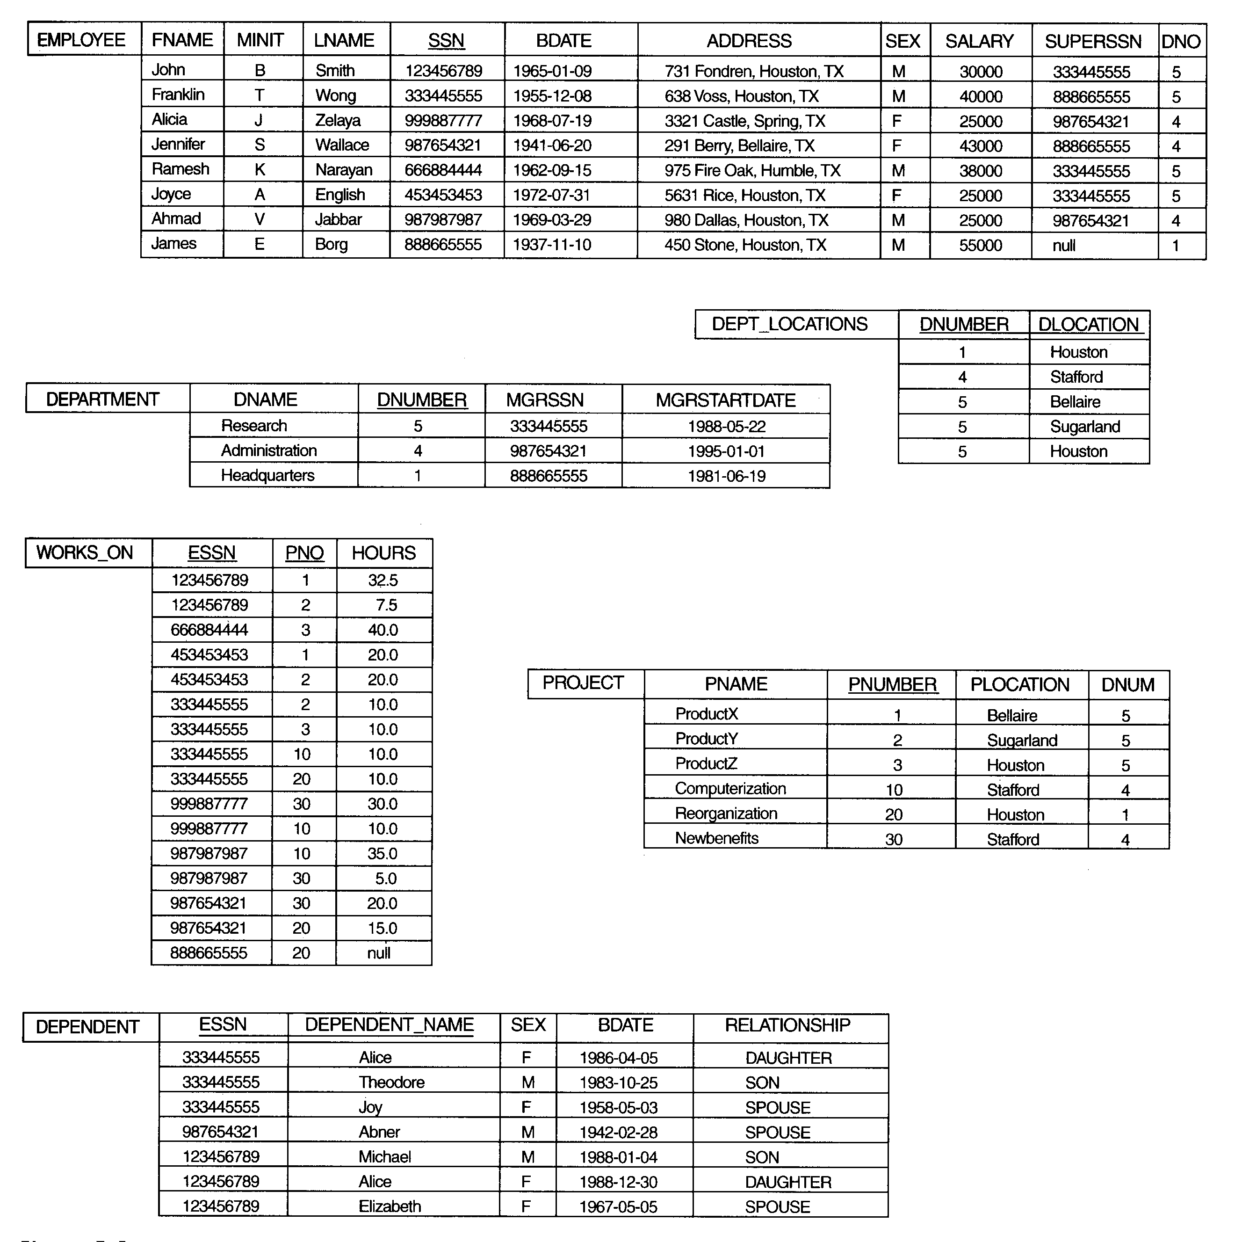
Company
One possible state of COMPANY

Slide 14
Entity integrity and referential integrity constraints
Entity integrity constraint: No primary key value can be null.
Referential integrity constraint
Maintain the consistency among tuples of the two relations.
A tuple in one relation that refers to another relation must refer to an existing tuple in that relation.

Slide 15
Foreign keys and semantic integrity constraints
Foreign keys constraint: A set of attributes FK in R₁ is a foreign key of R₁ that references R₂ if it satisfies
The attributes in FK have the same domain(s) as the primary key attributes PK of R₂.
A value of FK in a tuple t₁ of r₁(R₁) either occurs as a value of PK for some tuple t₂ in r₂ (R₂) or is null.
Semantic integrity constraints
The salary of an employee should not exceed the salary of the employee’s supervisor.

Slide 16
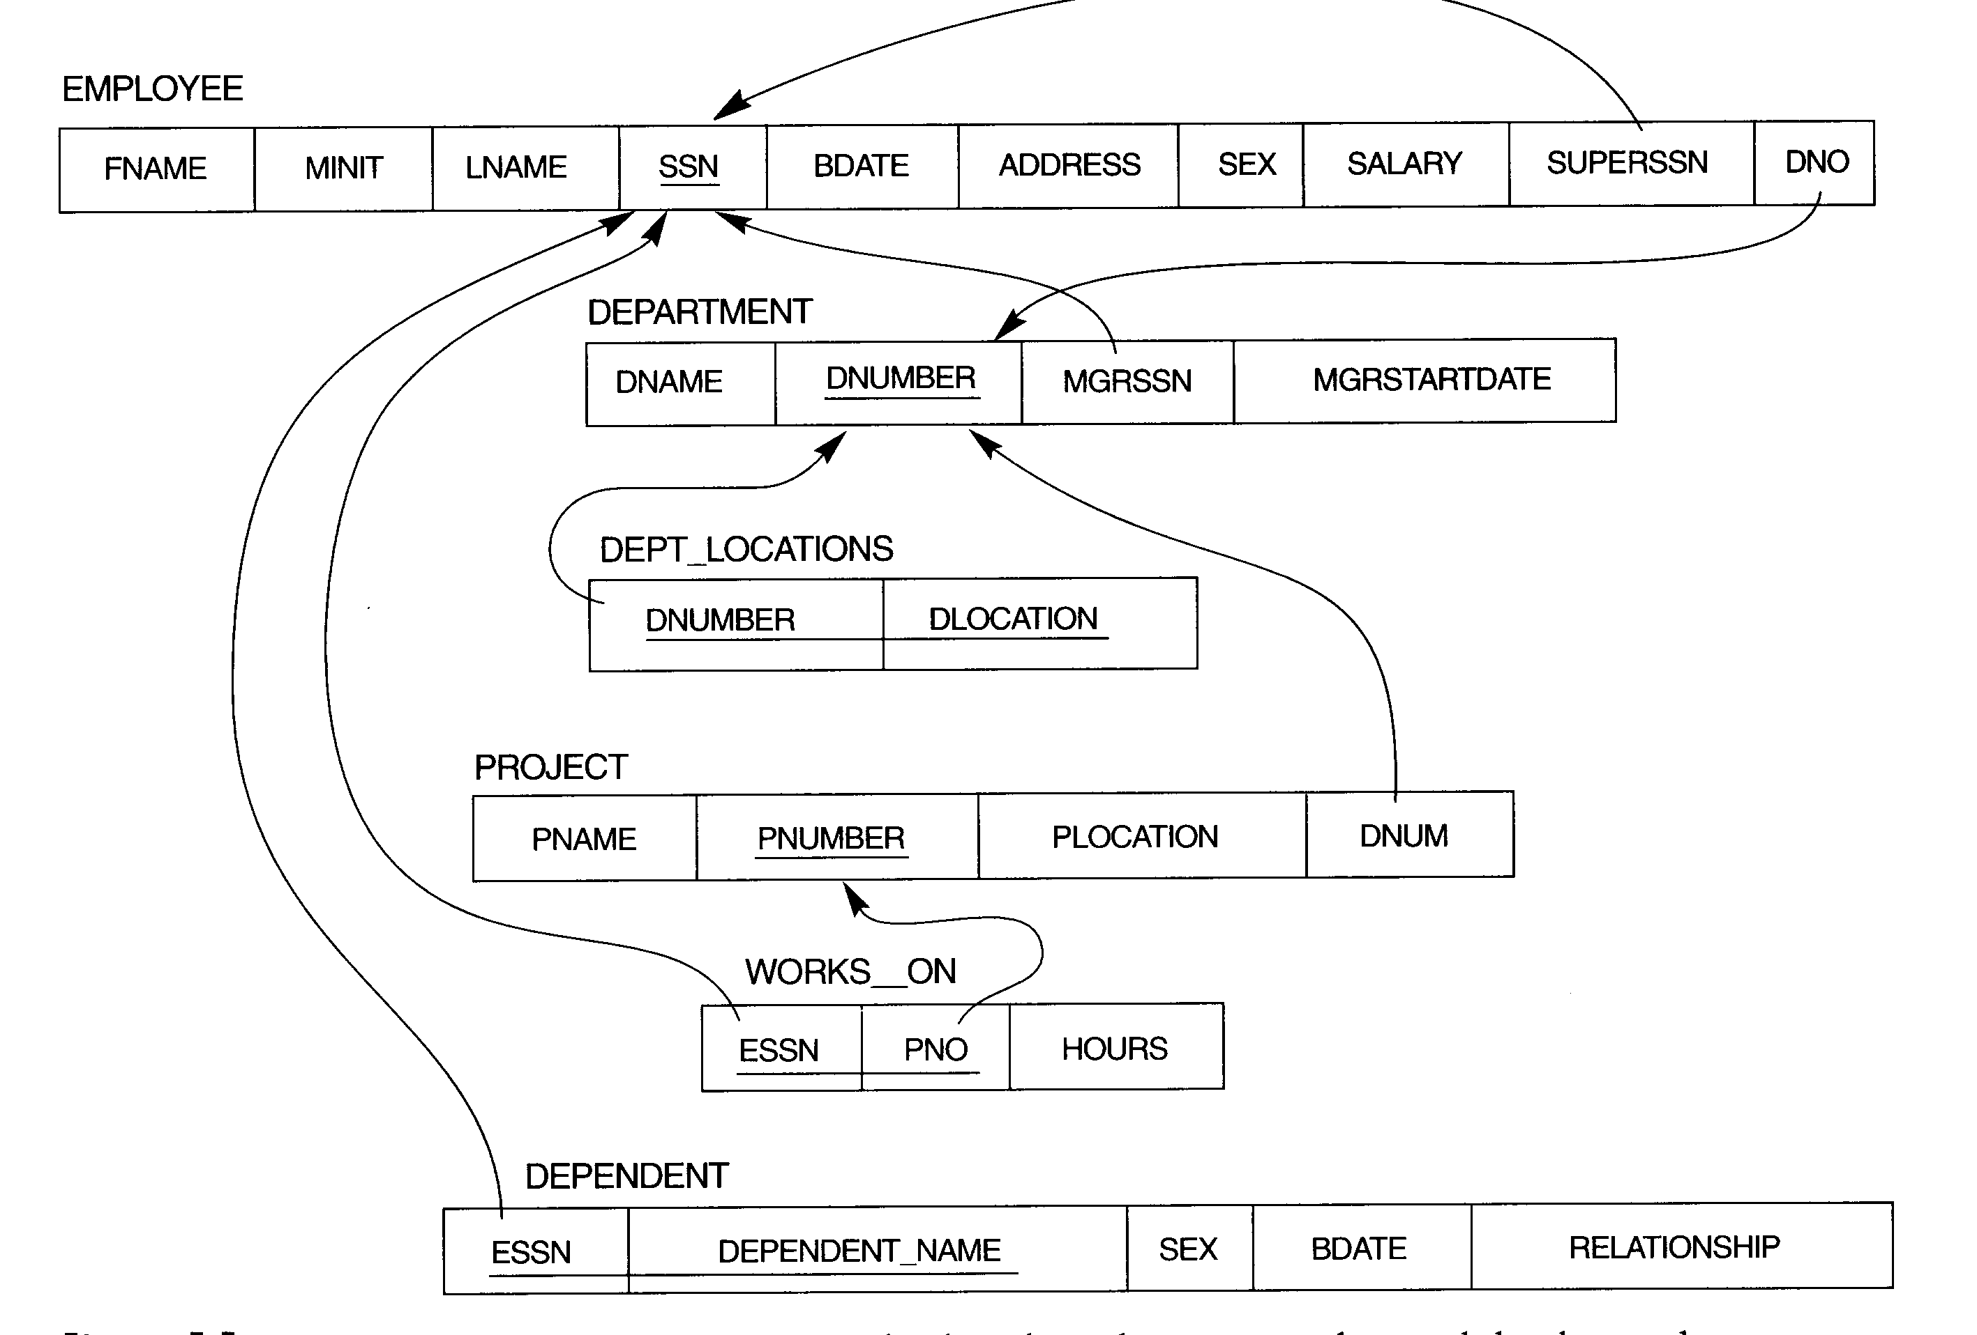
Referential integrity constraints

Slide 17
Update operations on relations
Insert
Insert <‘Cecilia’,’F’,’Kolonsky’,null,’05-APR-50’,’6357 Windy Lane,Katy, TX’, F, 28000,null,4> (entity integrity constraint)
Insert <‘Alicia’,’J’,’Zelaya’,’999887777’,’05-APR-50’ ,’6357 Windy Lane,Katy, TX’, F, 28000, ’987654321’,4> (key constraint: same SSN value)

Slide 18
Insert (cont’d)
Insert <‘Cecilia’,’F’,’Kolonsky’,677678989,’05-APR-50’, ’6357 Windy Lane,Katy, TX’, F, 28000,987654321,7> (referential integeity constraint: no department 7)
Insert <‘Cecilia’,’F’,’Kolonsky’,’677678989’,’05-APR-50’,’6357 Windswept,Katy, TX’, F, 28000,null,4> (acceptable)
Options:reject the insertion, correct the reason for rejecting the insertion

Slide 19
Delete
Delete can violate referential integrity
Delete the WORKS_ON tuple with ESSN=‘999887777’ and PNO=10 (acceptable)
Delete the EMPLOYEE with SSN=‘999887777’
(referential integrity: the tuple referenced by tuples in WORK_ON)
Delete the EMPLOYEE with SSN=‘333445555’
(referential integrity: the tuple referenced by tuples in EMPLOYEE, DEPARTMENT, WORKS_ON, and DEPENDENT)
Options:reject the delete, attempt to cascade the deletion, modify the referencing attribute values

Slide 20
Update
Modifying an attribute that is neither a primary key nor a foreign key usually causes no problems. (check domain)
Modifying a primary key is similar to deleting one tuple and inserting another in its place.

Slide 21
Select
σ_{<selection condition>}(<relation name>)
σ_{DNO=4}(EMPLOYEE)
σ_{SALARY>30000}(EMPLOYEE)
σ(DNO=4 OR DNO=5) AND (SALARY>30000)(EMPLOYEE)
Select operation is commutative
σ_{<cond1>}(σ_{<cond2>}(R))=σ_{<cond2>}(σ_{<cond1>}(R))
σ_{<cond1>}(σ_{<cond2>}(...(σ_{<condn>}(R))=
σ<cond1> AND <cond2> AND ... AND <condn>(R)

Slide 22
Company

Slide 23
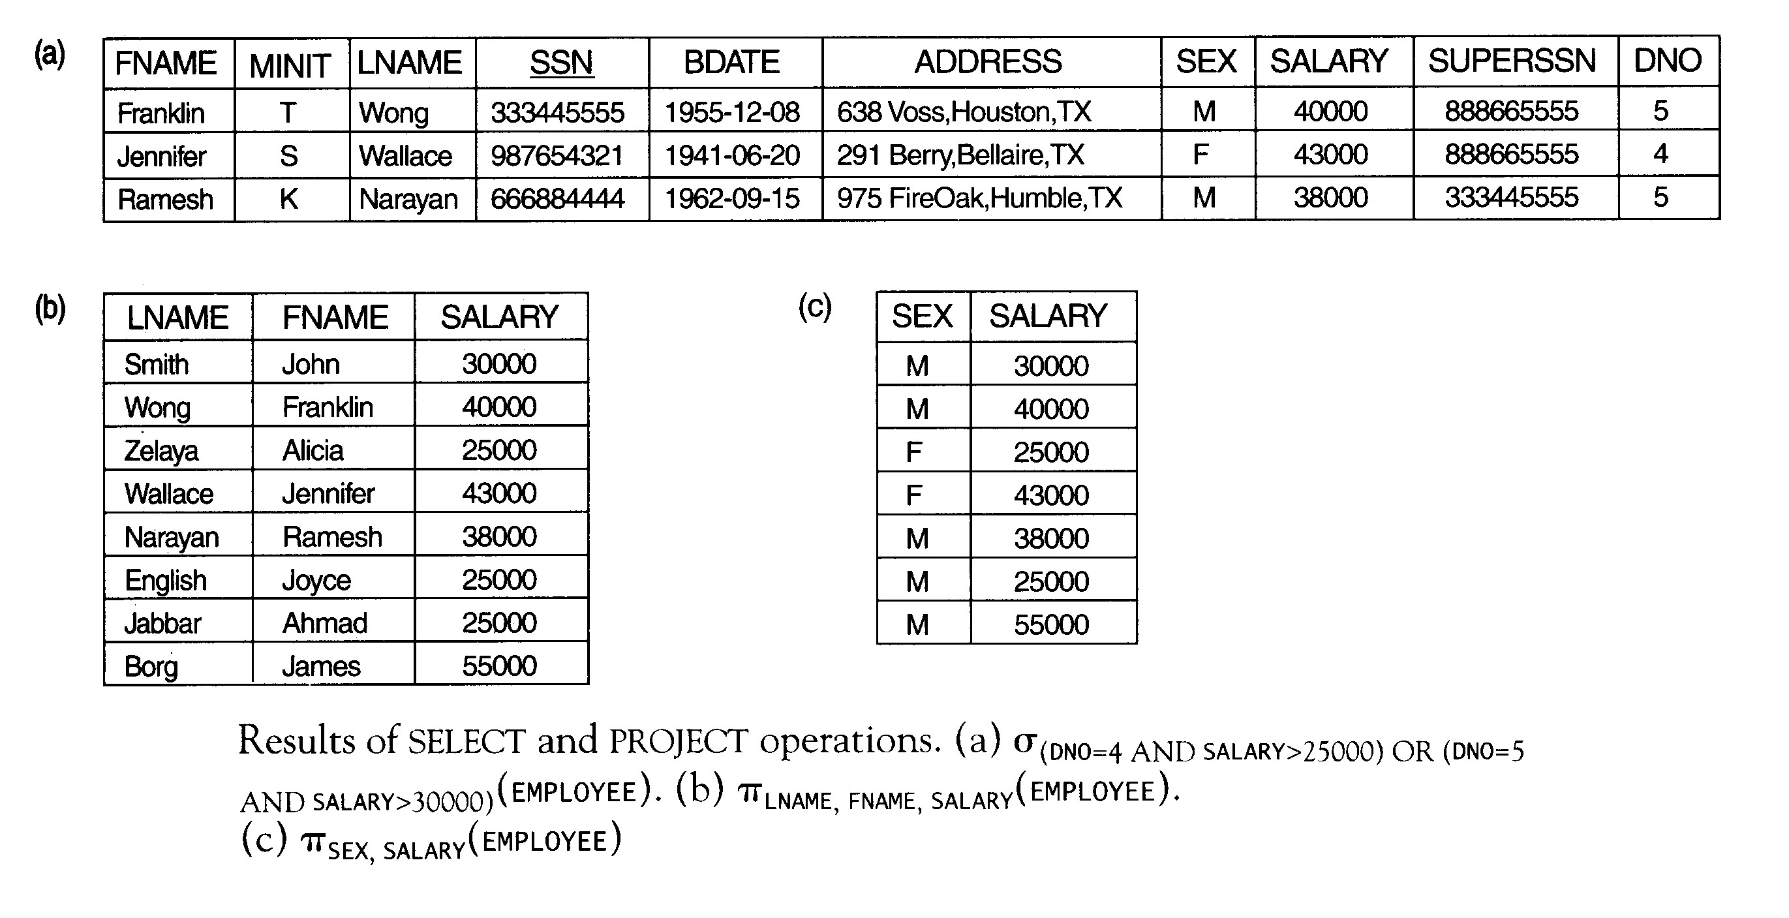

Slide 24
Project
π_{<attribute list>}(<relation name>)
π_{LNAME,FNAME,SALARY}(EMPLOYEE)
π_{SEX,SALARY}(EMPLOYEE)
π_{<list1>}(π_{<list2>}(R))=π_{<list1>}(R)

Slide 25
Sequences of operations and renaming of attributes
π_{FNAME,LNAME,SALARY}(σ_{DNO=5}(EMPLOYEE))
TEMP ← σ_{DNO=5}(EMPLOYEE)
R(FIRSTNAME,LASTNAME,SALARY) ← π_{FNAME,LNAME,SALARY}(TEMP)

Slide 26
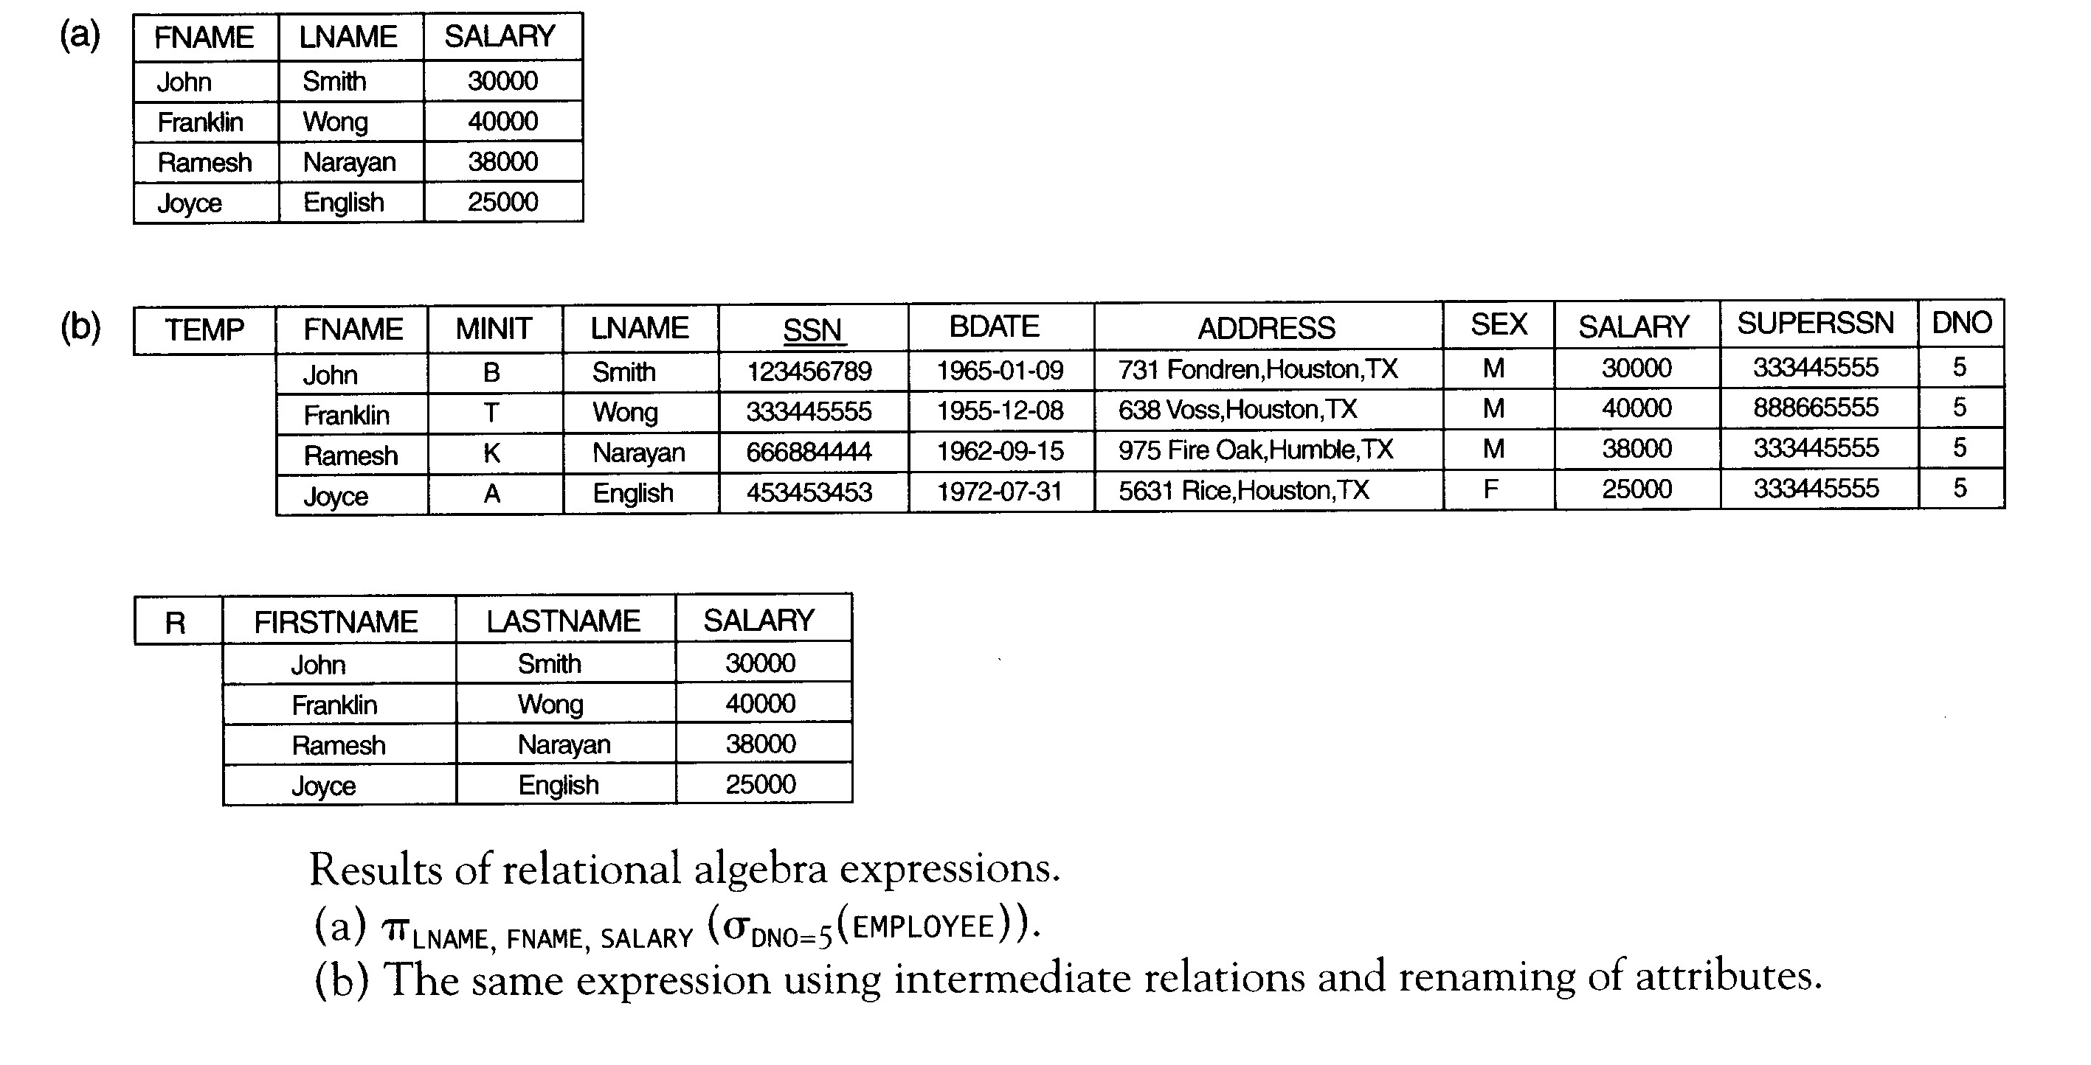

Slide 27
Set theoretic operations
Two relations R(A₁,A₂,...,A_{n}) and S(B₁,B₂,...,B_{n}) are said to be union compatible if they have the same degree n, and if dom(A_{i})=dom(B_{i}), for 1<i<n.
Union (R∪S)
Intersection (R∩S)
Difference (R−S)
Cartesian product (R×S)

Slide 28
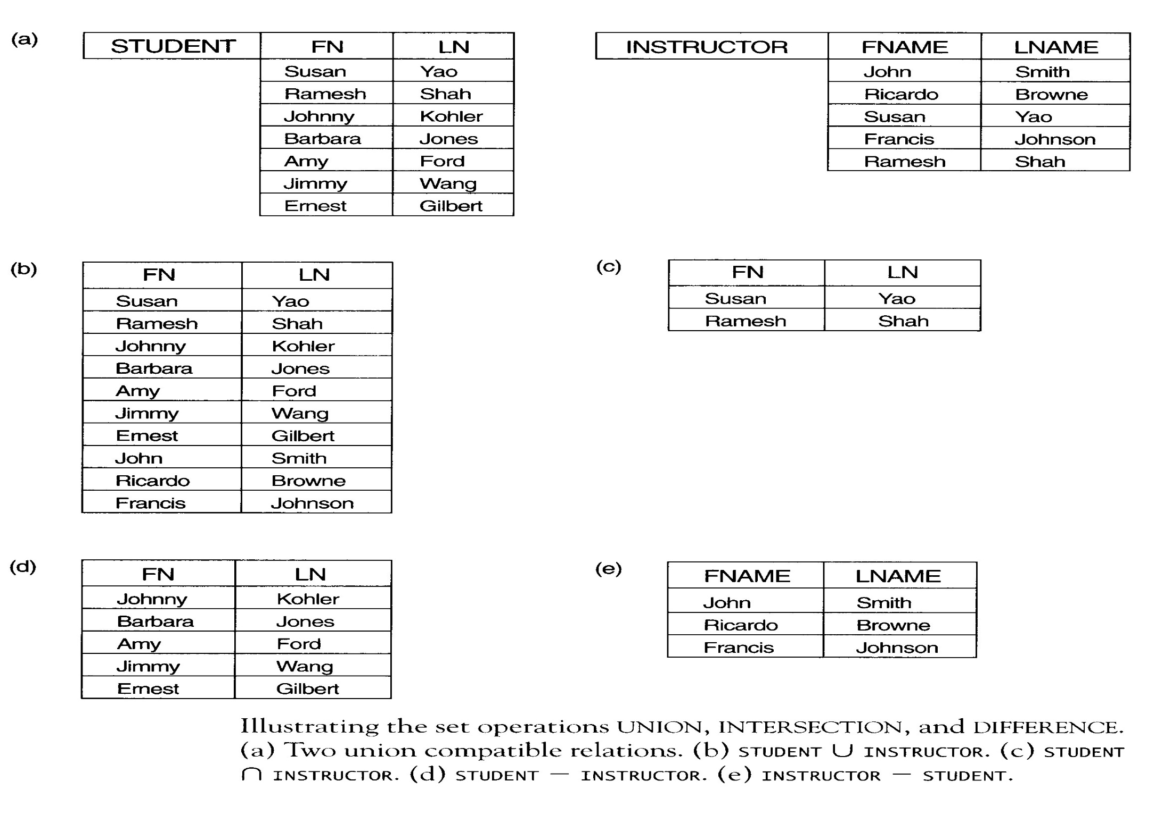

Slide 29
Cartesian product
Retrieve for each female employee a list of the names of her dependents
FEMALE_EMPS←σ_{SEX=F}(EMPLOYEE)
EMPNAMES ←π_{FNAME,} _{LNAME,SSN}(FEMALE_EMPS)
EMP_DEPENDENTS ←EMPNAMES× DEPENDENT
ACTUAL_DEPENDENTS ←σ_{SSN=ESSN}(EMP_DEPENDENTS)
RESULT ← π_{FNAME,LNAME,DEPENDENT_NAME}(ACTUAL_DEPENDENTS)

Slide 30
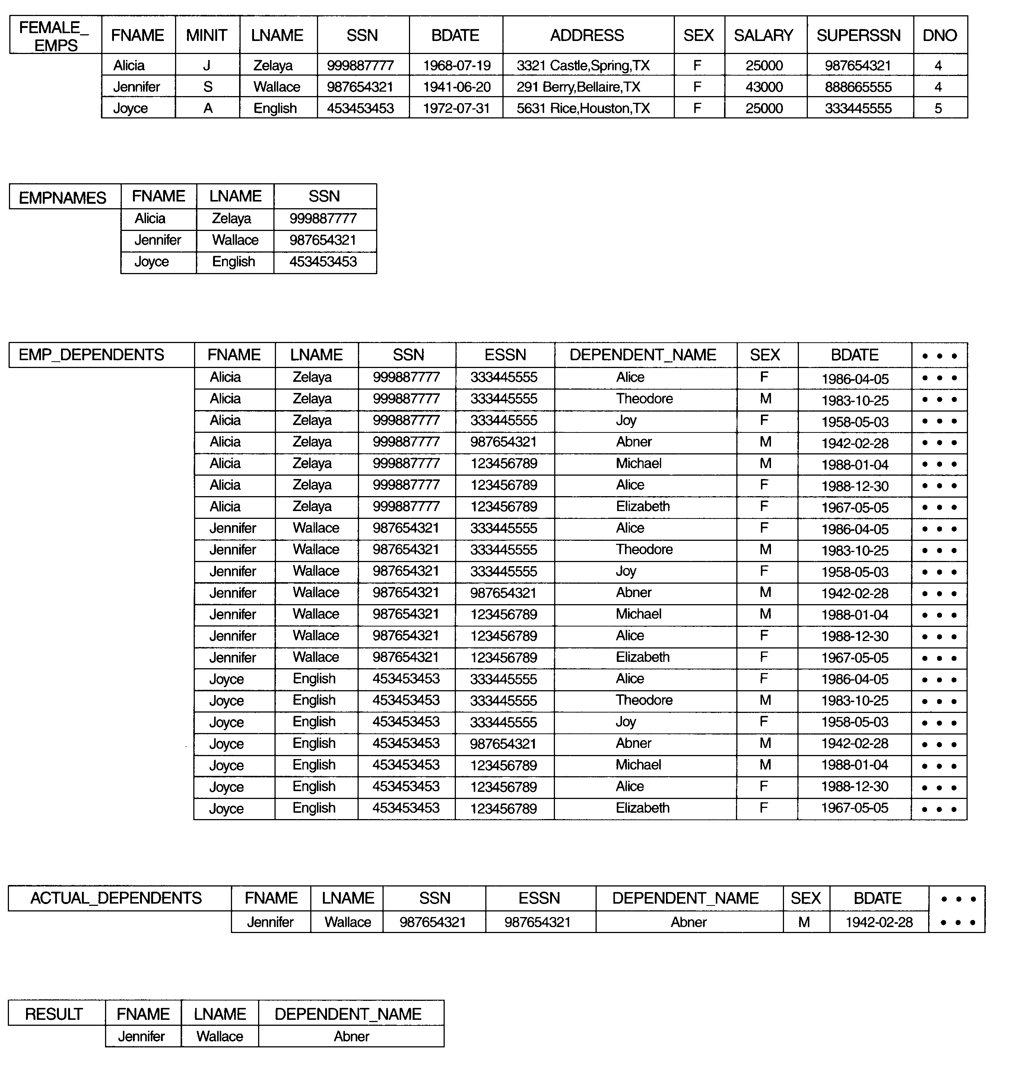

Slide 31
Join
Given two relations R(A₁,A₂,...,A_{n}) and S(B₁,B₂,...,B_{m}),
R _{<join condition>} S = Q(A₁,A₂,...,A_{n}, B₁,B₂,...,B_{m})
where the tuples in Q satisfy the join condition.
Θ-join AΘB, where Θ can be =,<,<,>,>,<>
Natural join (*) requires that the two join attributes have the same name.

Slide 32
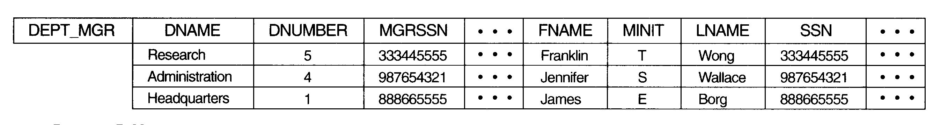
Example of the join operation
Retrieve the name of the manager of each department
DEPT_MGR← DEPARTMENT _{MGRSSN=SSN} EMPLOYEE
RESULT← π_{DNAME,LNAME, FNAME} (DEPT_MGR)

Slide 33
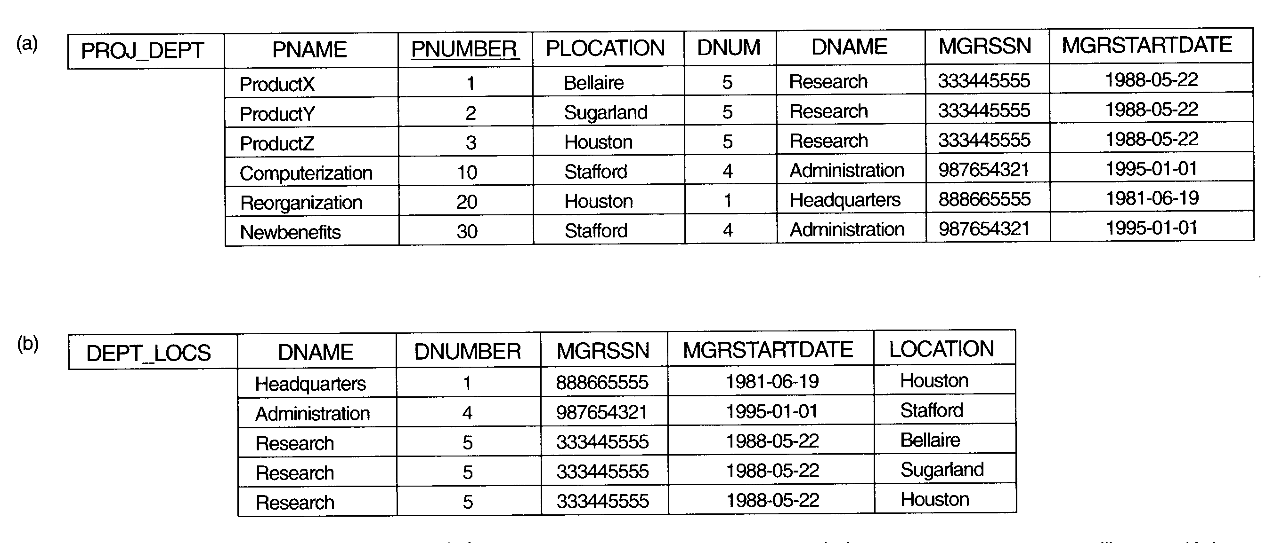
Example of the natural join
The natural join requires that the two join attributes have the same name in both relations.
PROJ_DEPT← PROJECT*DEPT; DEPT_LOCS ← DEPARTMENT*DEPT_LOCATIONS

Slide 34
Complete set of relational algebra
σ
π
∪
−
×
R∩S=(R∪S) −((R − S) ∪(S − R))
R _{<join condition>} S = σ_{<condition>}(R×S)

Slide 35
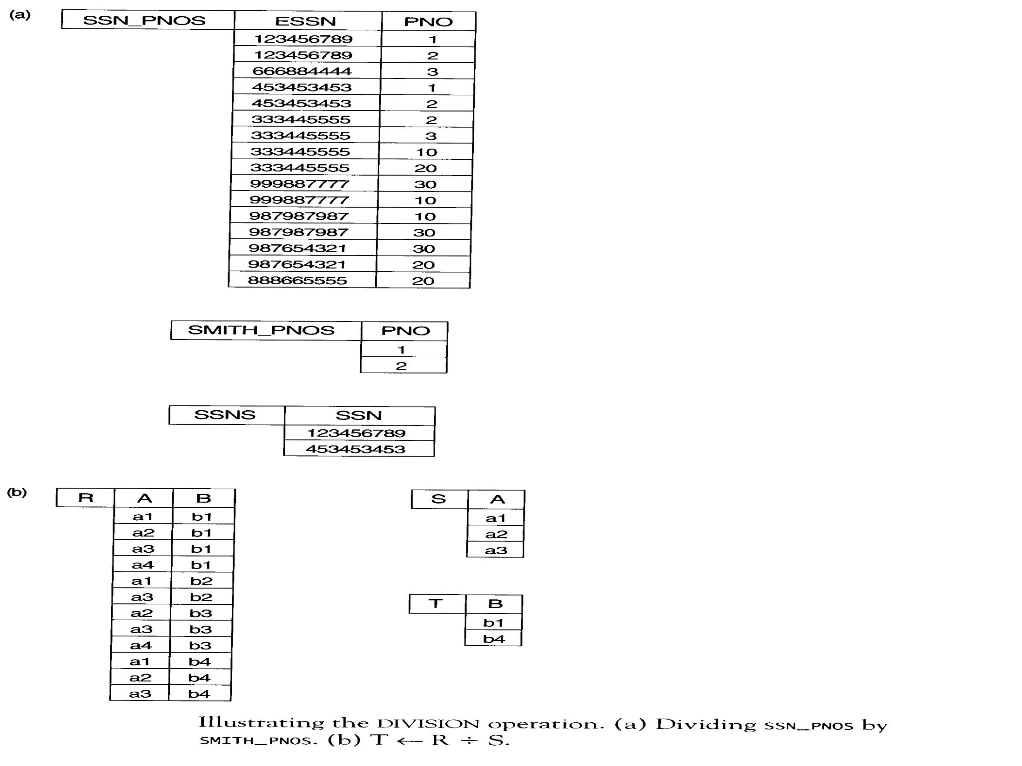
Division ÷

Slide 36
Division operation
Retrieve the names of employees who work on all the projects that John Smith works on
SMITH ←σ_{FNAME=‘John’ and LNAME=‘Smith’} (EMPLOYEE)
SMITH_PNOS ←π_{PNO}(WORKS_ON _{ESSN=SSN} SMITH)
SSN_PNOS ← π_{ESSN,PNO}(WORKS_ON)
SSNS(SSN) ← SSN_PNOS÷SMITH_PNOS
RESULT ← π_{FNAME,LNAME}(SSNS*EMPLOYEE)

Slide 37
Aggregate functions
Sum
Average
Maximum
Minimum
Count

Slide 38
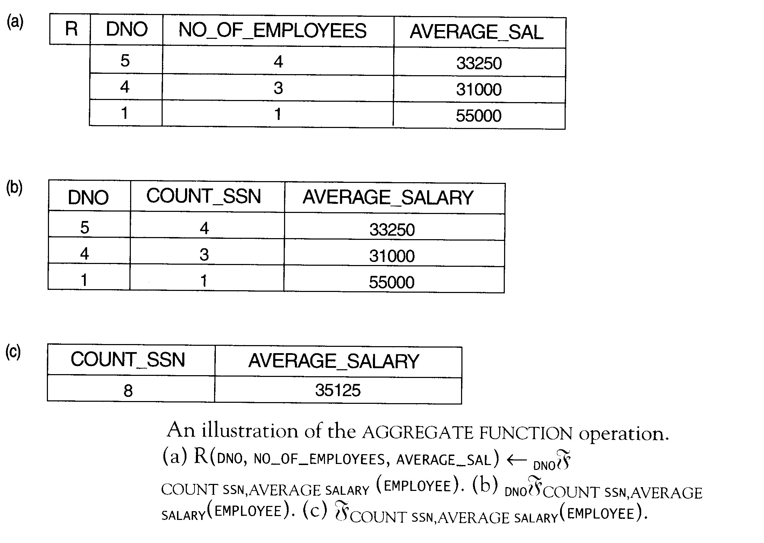

Slide 39
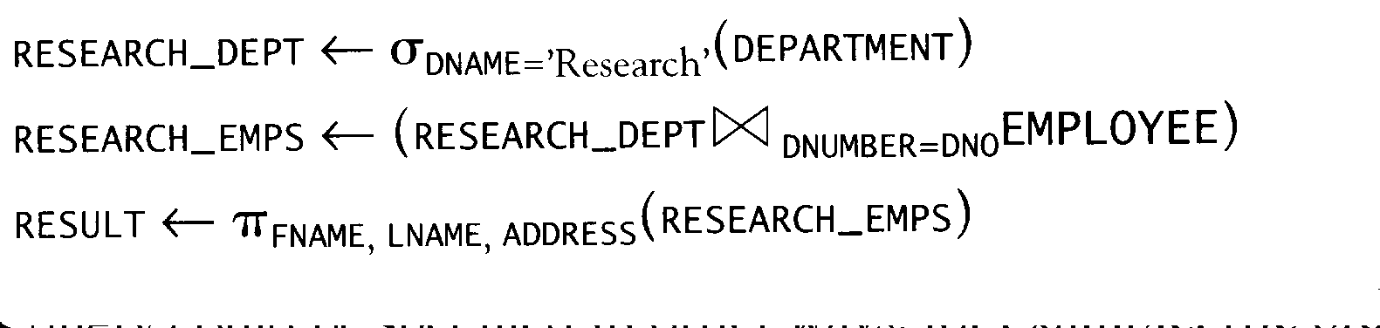
Example query 1
Retrieve the names and addresses of all employees who work for the ‘Research’ department.

Slide 40
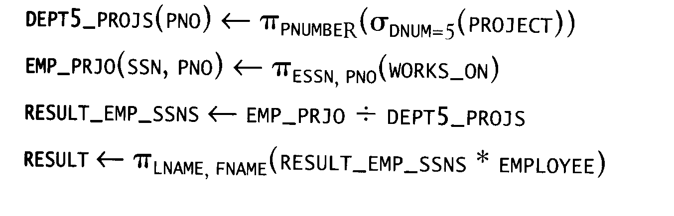
Example query 2
Find the names of employees who work on all the projects controlled by department number 5.

Slide 41
Company

Slide 42
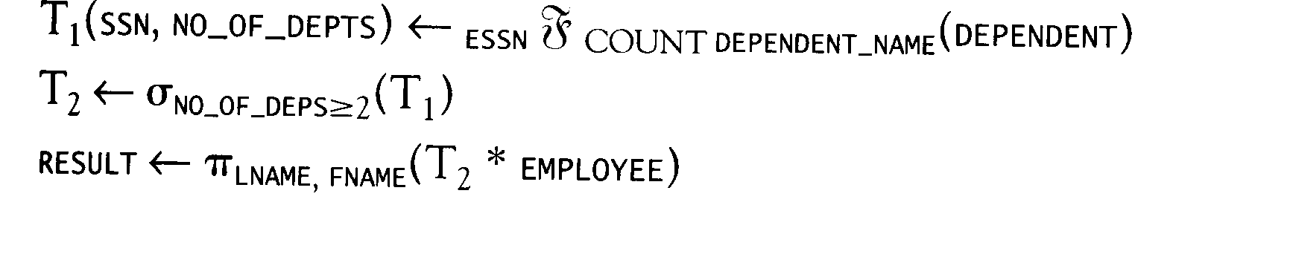
Example query 3
List the names of all employees with two or more dependents.

Slide 43
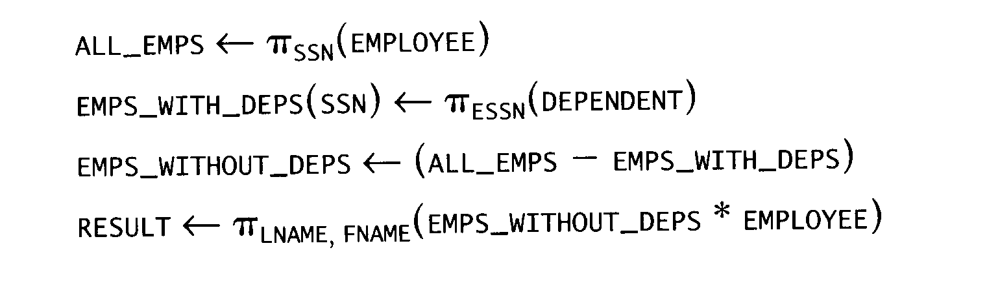
Example query 4
Retrieve the names of employees who have no dependents.

Slide 44
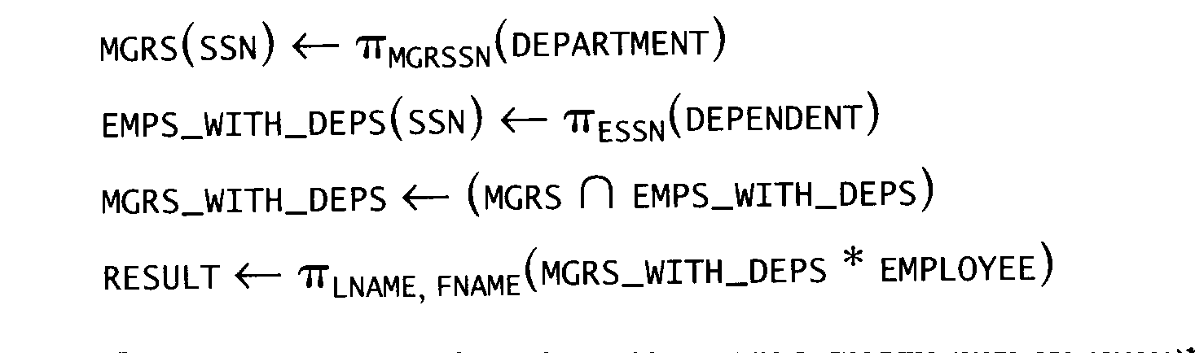
Example query 5
List the names of managers who have at least one dependent.

